Slide 1

Deep Learning in Video Games
by John Abraham Chandy
24030194
MSc CS AI 2nd year
Notes:
Deep Learning in video games enables AI agents to learn, adapt, and make intelligent decisions for more realistic and dynamic gameplay.

Slide 2
Abstract
Transformative Role of Deep Learning – Examines how deep learning is reshaping the video game industry.
Key Applications – Includes reinforcement learning for intelligent agents, procedural content generation, and real-time behavior adaptation.
Comparative Analysis – Covers transformer-based agents, multi-agent systems, and adaptive gameplay personalization.
Insights & Future Directions – Highlights current advances and potential opportunities.
Notes:
Procedural Content Generation (PCG) automatically creates game content—like levels, maps, or assets—using algorithms, reducing manual design effort and increasing replayability.

Slide 3
Terminology
Deep Learning – A subset of machine learning using neural networks to model complex patterns.
Reinforcement Learning – Training agents to make decisions by rewarding desired behaviors in an environment.
Procedural Content Generation – Automatically creating game content like levels, maps, or items using algorithms.
Adaptive Gameplay Personalization – Adjusting game behavior and difficulty in real-time based on player actions.
Notes:
Deep learning models complex patterns in video games, allowing AI to predict player behavior, generate realistic environments, and create adaptive gameplay.

Slide 4
Introduction
Revolutionizing Game Development – Deep learning is transforming how games are designed and played.
Smarter NPCs – Enables non-player characters to learn, adapt, and make decisions autonomously.
Dynamic Content Creation – Supports procedural generation of levels, assets, and environments.
Enhanced Player Experience – Facilitates adaptive gameplay and personalized experiences.
Notes:
n The Elder Scrolls V: Skyrim, NPCs adapt their behavior based on player actions—like fleeing, fighting, or interacting differently depending on the player’s reputation and past choices.

Slide 5
Topics
Transformer-Based Reinforcement Learning
Multi-Agent Deep Reinforcement Learning (MADRL)
Procedural Content and AI-Driven Narrative
SimBa for Real-Time Behavior
Residual-MPPI for Adaptive Control
Notes:
Adaptive Control in video games allows AI agents or systems to dynamically adjust their strategies and actions in response to changing game environments or player behavior.

Slide 6
Do We Need Transformers to Play FPS Video Games?
Notes:
Transformers are a neural network architecture designed to handle sequential data.

Slide 7
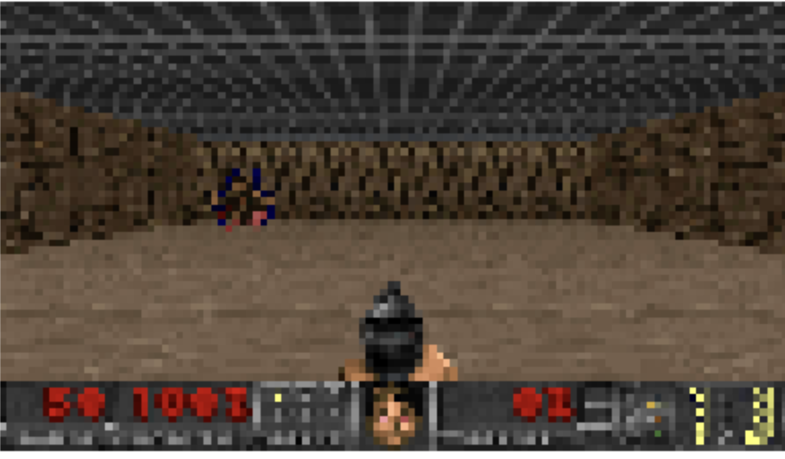
VizDoom Environment
Doom-based RL Platform – VizDoom is built on the classic 1993 Doom engine, providing a customizable environment for reinforcement learning (RL) research.
Pixel-based Input – Agents interact with the game using raw pixel observations, simulating human-like vision and decision-making.
Benchmark for AI Agents – Widely used for testing navigation, combat, and strategic decision-making in complex, partially observable environments.
Customizable Scenarios – Supports tasks like deathmatch, navigation, item collection, and shooting enemies, making it suitable for both basic and advanced RL experiments.
Benchmark FPS environment for RL research
Notes:
DQN combines reinforcement learning’s Q-learning with deep neural networks to approximate the Q-function (state–action value).

Slide 8
DTQN Architecture
Extension of DQN – Deep Transformer Q-Network (DTQN) enhances traditional Deep Q-Networks by replacing LSTMs with Transformer decoders.
Handles Partial Observability – Uses self-attention layers to capture long-term dependencies, making it effective in environments where the agent cannot fully observe the state.
Sequence Modeling – Processes sequences of observations (frames) rather than single snapshots, allowing the agent to maintain memory over time.
Training Pipeline – CNN encodes visual frames → Transformer layers process embeddings → Q-values predicted for each possible action using attention mechanisms.
Notes:
STMs are a type of Recurrent Neural Network (RNN) designed to overcome the vanishing/exploding gradient problems of standard RNNs.

Slide 9
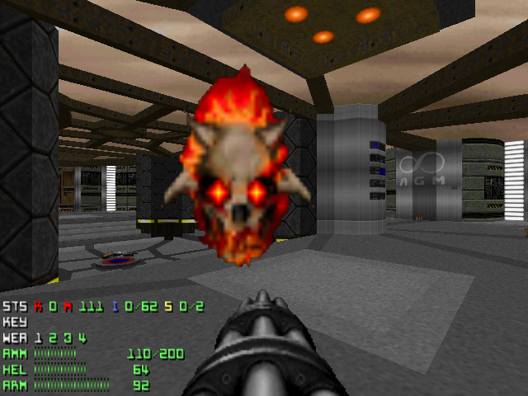
DTQN Architecture
Trajectory Representation – Each input sequence consists of return-to-go (𝑅), state (s), and action (a) tokens, representing past experiences.
Causal Transformer – A transformer processes these sequences using self-attention, capturing dependencies across time steps.
Embedding & Positional Encoding – Tokens are embedded and enriched with positional encodings before entering the transformer.
Action Prediction – The model predicts the next action (aₜ) based on past states, actions, and expected return, using a linear decoder.
Notes:
A mechanism that allows a model to focus on different parts of an input sequence when encoding a particular element.

Slide 10
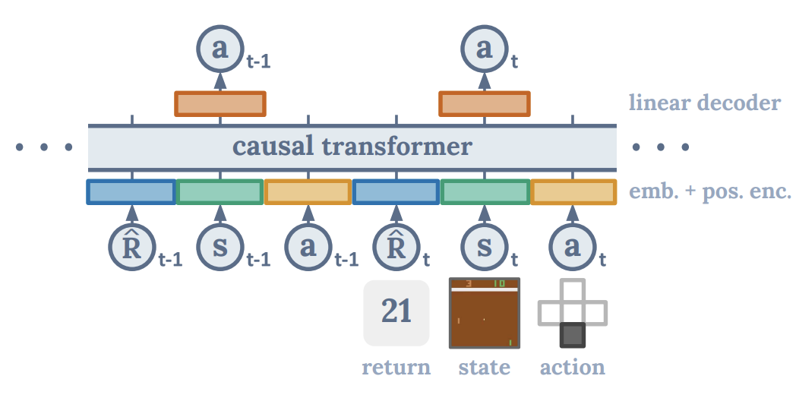
DTQN Architecture
Deep Transformer Q-Network with attention layers.
Notes:
linear decoder is the last fully connected (dense) layer that maps learned features to the final output

Slide 11
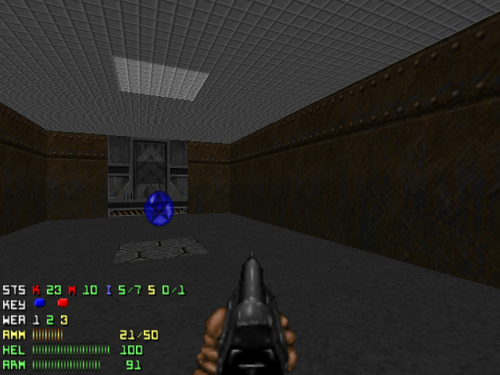
Decision Transformer
Reformulates RL – Treats reinforcement learning as a sequence modeling task rather than optimizing value functions.
Offline Training – Learns policies from static datasets of past trajectories without interacting with the environment.
Return-to-Go (RTG) Conditioning – Predicts next actions conditioned on desired future rewards.
Strengths & Limitations – Good for structured tasks (e.g., MuJoCo) but struggles in memory-intensive FPS games.
Notes:
physics simulator designed for robotics and reinforcement learning research. MuJoCo

Slide 12
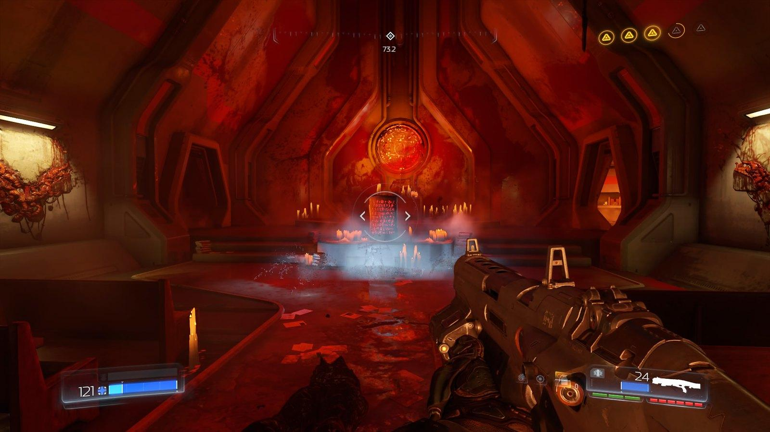
Decision Transformer
Observation Processing – A sequence of past observations (frames) is embedded and combined with positional encodings to preserve temporal order.
Transformer Layers – Multiple masked multi-head self-attention layers process the sequence, enabling the model to capture long-term dependencies.
Q-Value Estimation – The transformer outputs action-value estimates (Q-values) through a linear layer, which are compared using the Bellman error for training.
Action Selection & Learning – The agent selects actions via argmax over Q-values, interacts with the environment, and updates based on reward-driven loss.
Notes:
Instead of a single attention calculation, the model uses multiple “heads” to learn different types of relationships in parallel

Slide 13
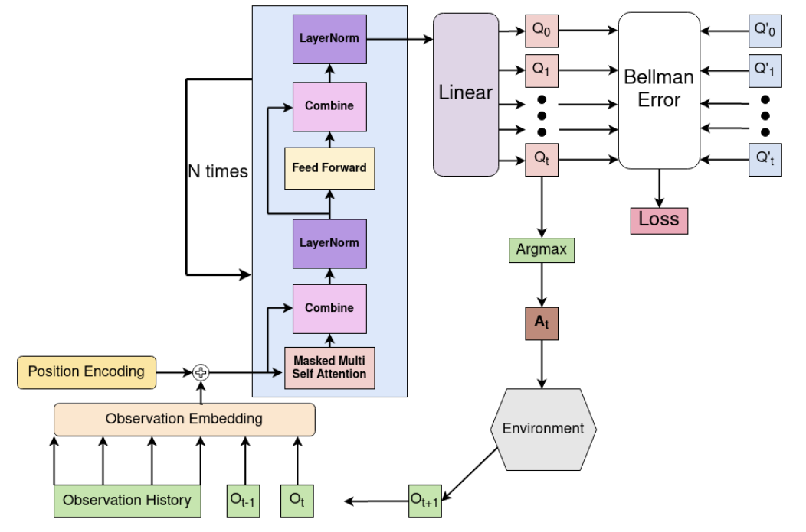
Decision Transformer
Offline RL with sequence modeling.
Notes:
bellman error measures the difference between the current Q-value estimate and the target Q-value predicted by the Bellman equation.

Slide 14
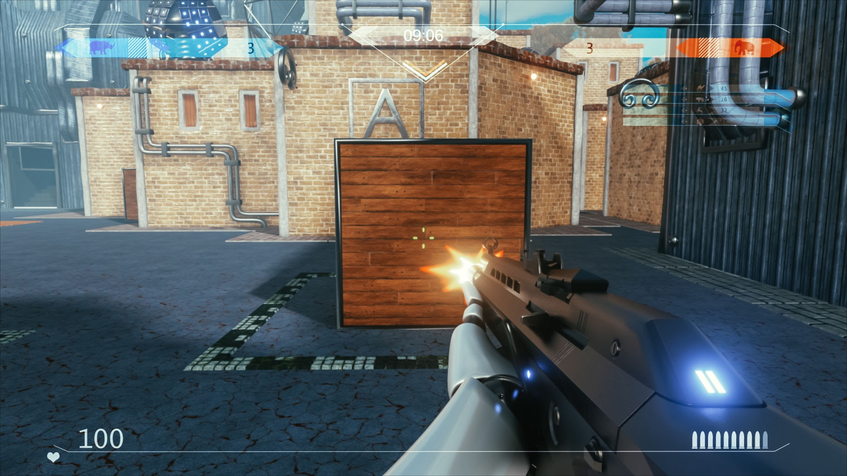
Online Reinforcement Learning (RL)
Continuous Interaction – Agent directly interacts with the environment, receiving new states and rewards in real time.
Exploration & Learning – Learns optimal policies by trial-and-error through continuous feedback.
Adaptability – Can adjust policies dynamically as the environment changes.
Challenge in FPS – Requires strong memory and strategy; recurrent models (e.g., DRQN with LSTMs) often outperform transformers.
Notes:
A Q-value, or action-value, represents the expected future cumulative reward of taking an action a in state s, and then following the optimal policy.

Slide 15
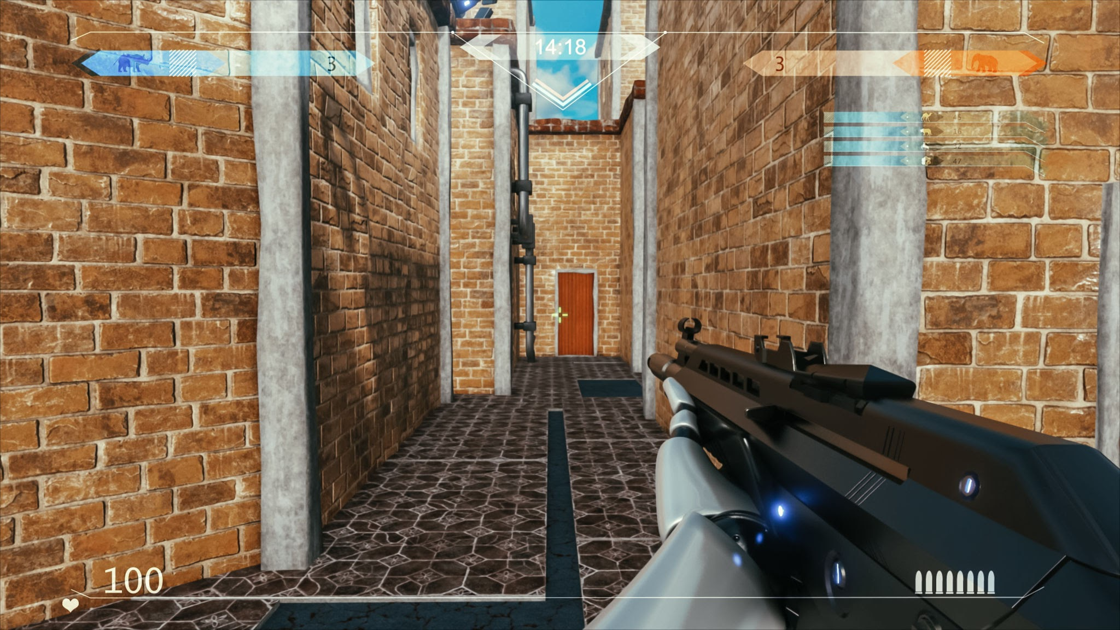
Results - DT vs PPO
Decision Transformer Limitations – Trained on offline trajectories, DT showed unstable and suboptimal policy learning.
PPO Advantage – Proximal Policy Optimization (PPO) achieved higher and more consistent rewards compared to DT.
Challenge in FPS Games – DT struggled with memory-intensive tasks such as enemy engagement and strategy, exposing its weakness in complex FPS settings.
Graph Insight – X-axis shows training steps, Y-axis shows episode returns; the DT curve fluctuates heavily, mostly staying negative, indicating poor convergence and inability to learn an effective policy.
Notes:
einforcement learning algorithm that directly learns a policy (probability distribution over actions) instead of Q-values.

Slide 16
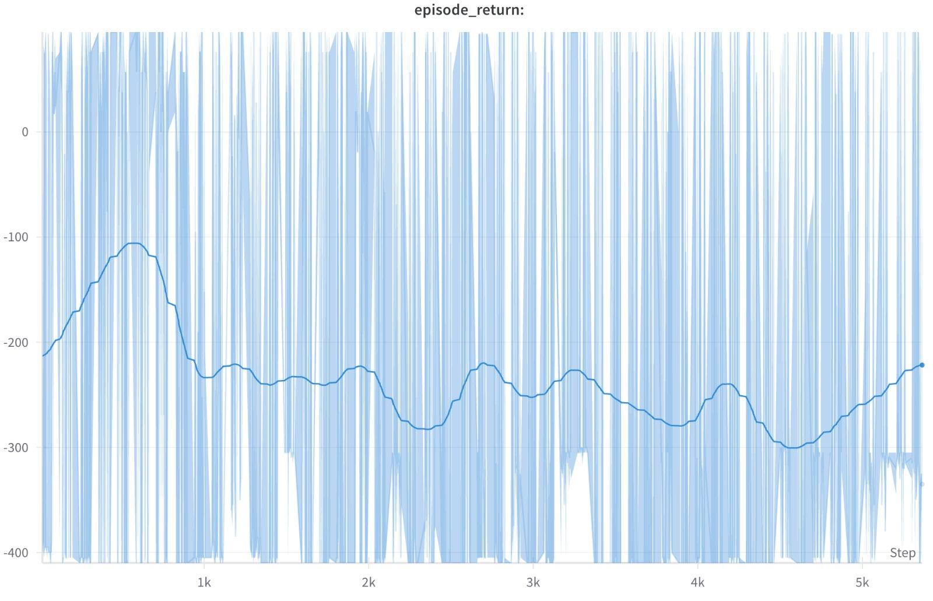
Results - DT vs PPO
Comparison of episode rewards.
Notes:
episode is a complete sequence of interactions between an agent and the environment, starting from an initial state and ending at a terminal state

Slide 17
Results - DQN+DRQN vs DTQN
Stable Performance – PPO achieved consistently high episode returns, showing strong learning stability compared to DT.
Efficient Training – The curve flattens quickly, meaning PPO converges to a good policy faster than DT.
Robust Policy – Even with some fluctuations, PPO maintained positive rewards throughout most episodes.
Graph Explanation –
X-axis: Episode count (training progress).
Y-axis: Episode return (cumulative reward per episode).
Shows PPO policies consistently above zero with minimal drops.
Notes:
DRQN combines Deep Q-Networks (DQN) with Recurrent Neural Networks (RNNs/LSTMs) to handle partially observable environments.

Slide 18
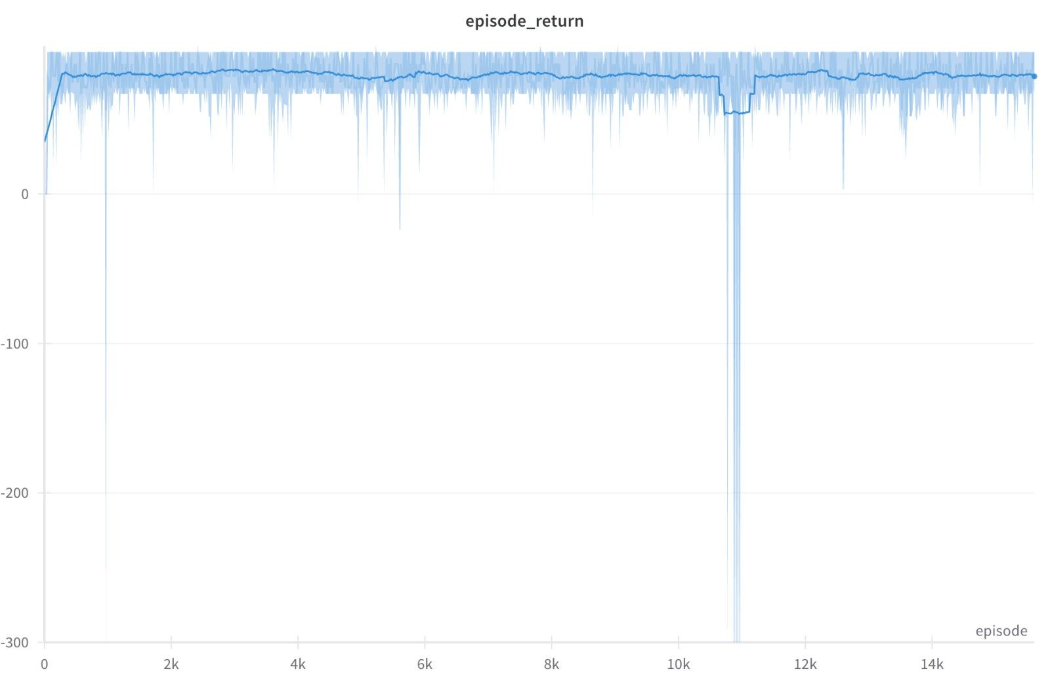
Results - DQN+DRQN vs DTQN
Kill/Death ratio comparison.
Notes:
policy strategy that an agent follows, mapping states of the environment to actions to be taken.

Slide 19
Why is MADRL a promising approach for making intelligent games?
Notes:
Partial observability means an agent cannot fully observe the true state of the environment.

Slide 20
Multi-Agent Deep Reinforcement Learning (MADRL)
Definition – MADRL extends reinforcement learning to environments with multiple agents, each learning and interacting simultaneously.
Coordination & Competition – Agents may cooperate, compete, or both, making policy learning more complex than single-agent RL.
Key Challenges – Includes partial observability, non-stationarity, scalability, and heterogenous agents when evaluating team contributions.
Applications – Used in robotics, autonomous driving, strategy games, simulations, and large-scale AI systems.
Notes:
process of optimizing an agent’s strategy (policy) for selecting actions based on its observations or states.

Slide 21
MADRL
Core Challenges – MADRL in games faces heterogeneous agents, partial observability, non-stationarity, scalability, and credit assignment issues.
Solution Paradigms – Research addresses these through communication structures, training paradigms, and scalability-enabling methods.
Benchmarks & Applications – Benchmarks like SMAC, MAgent, Google Football, and OpenSpiel support research, while real-world apps include DeepNash, Honor of Kings AI, and Gran Turismo AI.
Research Outlook – The field combines theoretical foundations, algorithmic development (VDN, QMIX, MAPPO, etc.), and identifies open issues such as explainability and model-based approaches.
Notes:
Heterogeneous agents are agents with different abilities, roles, or action spaces within the same environment.

Slide 22
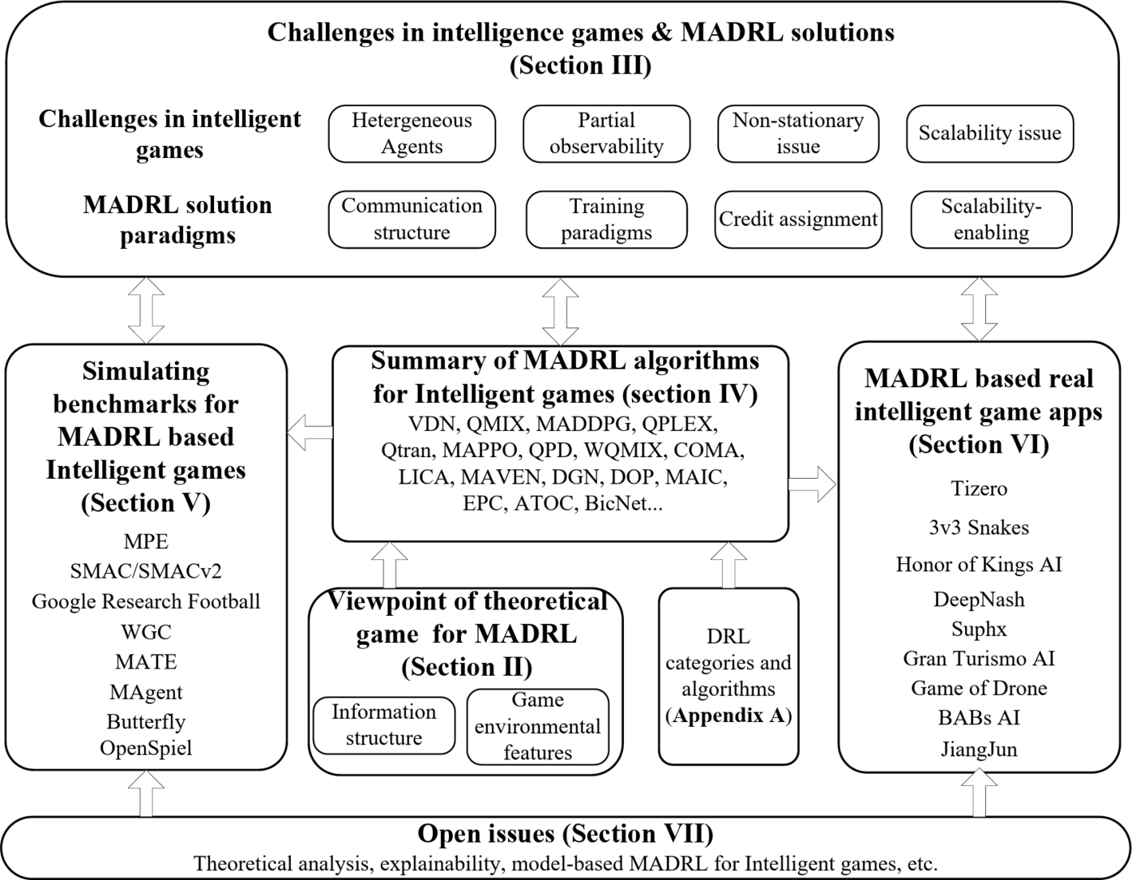
MADRL
Notes:
Credit assignment is the problem of determining which agent’s action contributed to the overall team reward in a multi-agent environment.

Slide 23
Model Architecture
Game Challenges (C1–C4) – Intelligent games face issues like heterogeneous players, partial observability, non-stationarity, and scalability that complicate AI design.
MADRl Solutions (S1–S4) – To address these, MADRL introduces communication structures, credit assignment methods, training paradigms, and scalability-enabling techniques.
Mutual Benefit – MADRl enhances games by guiding AI design, while games inspire MADRL by serving as realistic testbeds for improvement.
Bidirectional Relationship – The framework highlights a two-way interaction: MADRL solves game AI challenges, and games, in turn, drive further MADRL research.
Notes:
Game AI design is about creating intelligent agents or systems that can interact with players, adapt to environments, and enhance gameplay experiences.

Slide 24
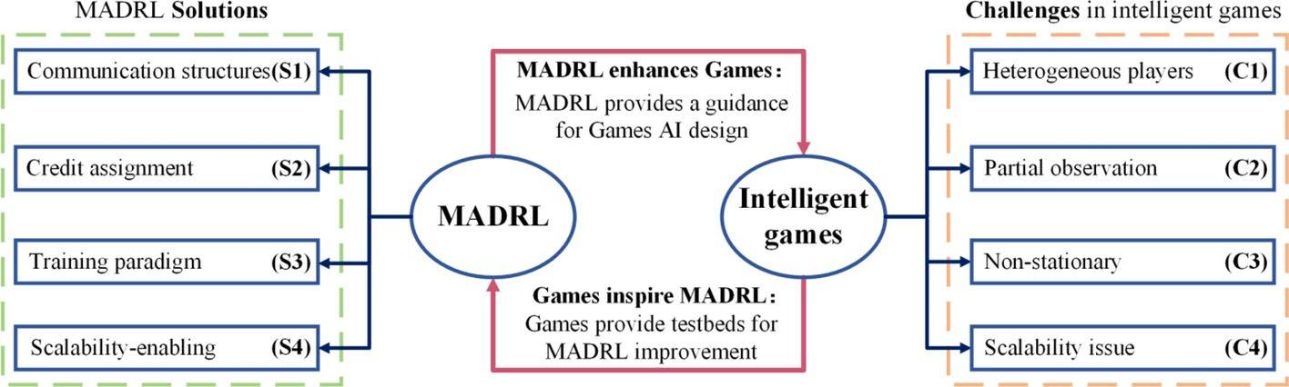
Model Architecture
Architecture diagrams showing proposed models.
Notes:
testbed is a benchmark environment or platform used to train, evaluate, and compare AI algorithms in controlled, repeatable settings.

Slide 25

Comm-MARL (Communication in Multi-Agent RL)
Communication Constraints – Agents face challenges like limited bandwidth, noisy channels, and shared mediums, making reliable communication difficult.
Message Format – Communication can be defined in terms of what to communicate (local observations or historical information) and whom to communicate with (all agents vs. selected agents).
Communication Strategies – Methods include broadcasting to all, centralized proxy-based communication, predefined structured messaging, or learnable communication protocols.
Importance in MARL – Effective communication enables coordination, cooperation, and efficient teamwork among agents, which is crucial in complex environments like intelligent games.
Notes:
Comm-MARL focuses on how agents exchange information with each other to improve coordination and decision-making in multi-agent environments.

Slide 26
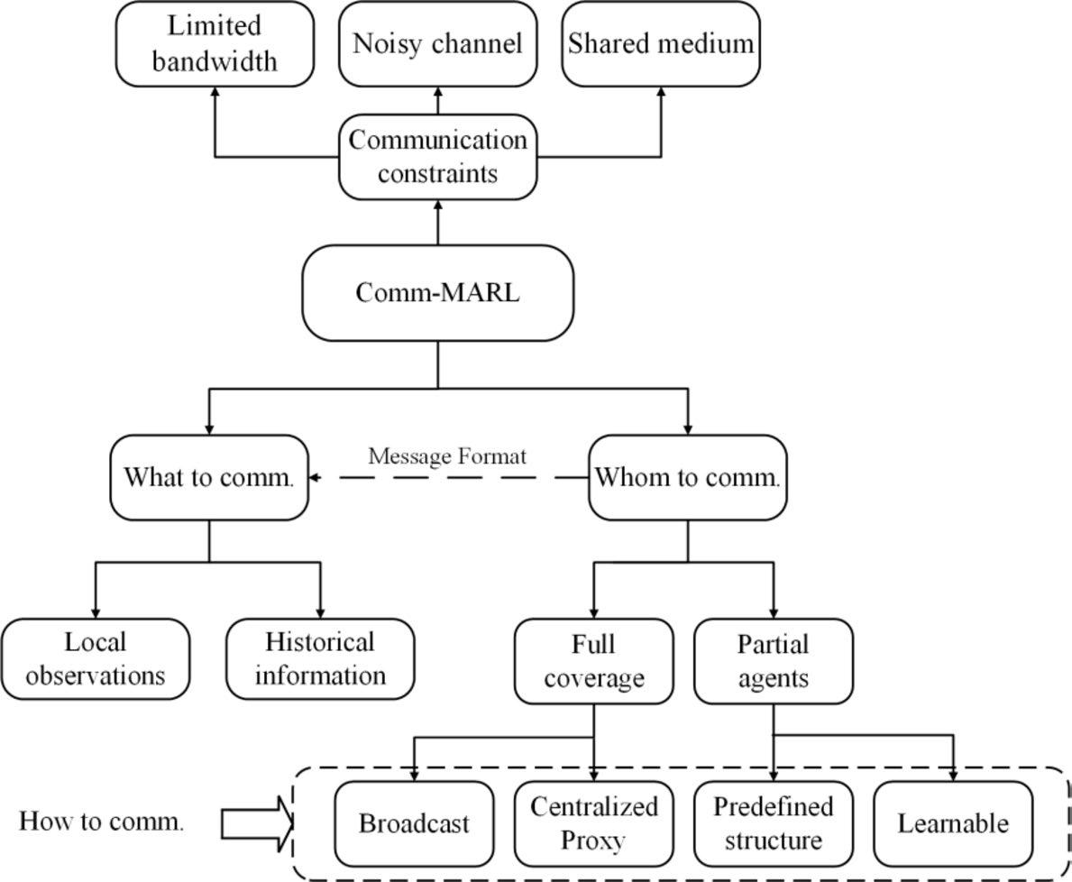
Comm-MARL (Communication in Multi-Agent RL)
Notes:
A centralized proxy is an intermediate hub (like a server or controller) that collects information from multiple agents and redistributes it as needed.

Slide 27
Training & Execution Paradigms in MARL
CTCE (Centralized Training, Centralized Execution) – Both training and execution rely on a central controller, giving agents complete access to global states and actions.
DTDE (Decentralized Training, Decentralized Execution) – Each agent learns and acts independently, without relying on shared information, suitable for fully distributed systems.
CTDE (Centralized Training, Decentralized Execution) – A widely used paradigm where agents are trained with global information but execute policies independently using local observations.
Key Insight – These paradigms balance information sharing, scalability, and autonomy; CTDE is often preferred for complex environments like games due to its balance of efficiency and realism.
Notes:
A proxy is an intermediate entity that acts on behalf of agents, handling communication, decision routing, or resource sharing.

Slide 28
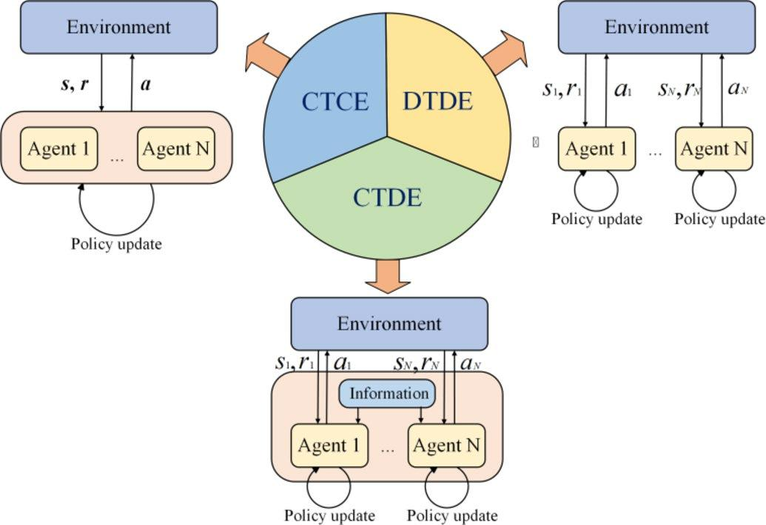
Training & Execution Paradigms in MARL
Notes:
Policy update is the process of adjusting an agent’s strategy (policy) to improve decision-making based on experience.

Slide 29
How can AI enhance game development while balancing creativity, efficiency, and ethical responsibility?
Notes:
NPCs are game characters controlled by the computer/AI, not by a human player.

Slide 30
Introduction
• Traditional NPC interactions are script-based, limiting flexibility.
• AI-driven approaches (LLMs, deep learning) enable dynamic dialogues and adaptive behaviors.
• AI reduces developer workload while enhancing player immersion.
• Need to study effectiveness, player satisfaction, and ethical risks of AI in games.
Notes:
SceneCraft is an AI framework that integrates Large Language Models (LLMs) into game NPCs to generate dynamic dialogues and behaviors.

Slide 31
AI-driven NPC Interaction
• Traditional NPCs use behavior trees/finite state machines: predictable but rigid.
• Deep learning enables agents to adapt, collaborate, and compete more naturally.
• LLMs allow NPCs to hold dynamic dialogues, e.g., SceneCraft framework.
• Enhances immersion in RPGs, adventure games, and social simulations.
Notes:
Sokoban is a classic puzzle video game where a player pushes boxes (crates) to designated goal positions inside a maze-like warehouse.

Slide 32
Procedural Content Generation
• LLMs like GPT-2 can generate novel and playable levels (e.g., Sokoban, MarioGPT).
• GANs used for map layout and terrain design (Volz et al.).
• Dynamic Difficulty Adjustment (DDA) balances challenge based on player behavior.
• AI-generated levels maintain creativity, diversity, and playability.
Notes:
MarioGPT is a Generative AI model based on GPT-2 that can create new, playable levels for the classic game Super Mario Bros.

Slide 33
Game Development Process Optimization
• AI assists in automated script generation, testing, and optimization.
• Cloud-based AI allows more scalable NPC behavior than local CPU-driven AI.
• Speeds up prototyping and improves efficiency for developers.
• Example: Dragon's Dogma 2 with AI-driven independent NPCs.
Notes:
Dragon’s Dogma is already known for its pawn system, where your AI companions learn from your actions and can be shared with other players.

Slide 34
User Feedback
• 72% of developers view AI positively for narrative and efficiency gains.
• AI tools save ~30% of designers' working time in prototyping.
• Players enjoy immersive NPCs (e.g., Stardew Valley with GPT-NPC).
Notes:
Stardew Valley is a farming simulation and life RPG where the player interacts with townsfolk, grows crops, raises animals, and builds relationships.

Slide 35

Ethical Responsibility
Boost Creativity & Efficiency
Ensure Fair and Inclusive Content
Protect Player Privacy & Well-Being
Human Oversight & Accountability
Notes:
Keep humans in the loop to review AI outputs, ensure originality, and maintain ethical standards in game design. last point

Slide 36
Why is SimBa used in deep reinforcement learning for game environments?
Notes:
SimBa is a framework that helps deep RL scale up with more parameters safely, improving learning efficiency and performance across multiple environments.

Slide 37

SimBa
SimBa introduces a simplicity bias to enable scaling up parameters in deep RL, addressing the risk of overfitting while improving generalization.
Architecture integrates three components: observation normalization, residual feedforward blocks, and layer normalization for stable and efficient learning.
Enhances sample efficiency across diverse RL algorithms, including off-policy, on-policy, and unsupervised methods.
Applied to Soft Actor-Critic (SAC), SimBa matches or surpasses state-of-the-art performance on benchmarks like DMC, MyoSuite, and HumanoidBench.
Notes:
SIMPLICITY BIAS natural tendency of neural networks to learn simpler, more generalizable patterns instead of overly complex ones, even when they have the capacity to memorize.

Slide 38
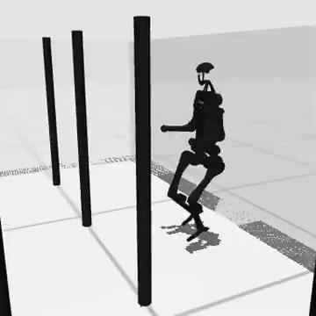
SimBa Improves Performance Across RL Algorithms
Comparison Across Settings – The figure shows results for Off-Policy (MF & MB), On-Policy, and Unsupervised RL methods, comparing baseline algorithms with and without SimBa.
Performance Boost – In all cases (SAC, TD-MPC2, PPO, METRA), adding SimBa consistently leads to higher returns across environment steps, demonstrating improved learning efficiency.
Sample Efficiency – The curves with SimBa (orange) reach strong performance faster than baselines (grey), showing that SimBa makes RL training more sample-efficient.
Robust Generalization – The consistent improvement across diverse RL algorithms and tasks (DMC, Craftax, Humanoid) highlights SimBa’s broad applicability and effectiveness.
Notes:
DMC – DeepMind Control Suite for physics-based continuous control tasks. Craftax – Resource-management environment inspired by Minecraft. Humanoid – Benchmark for complex humanoid locomotion and control.

Slide 39
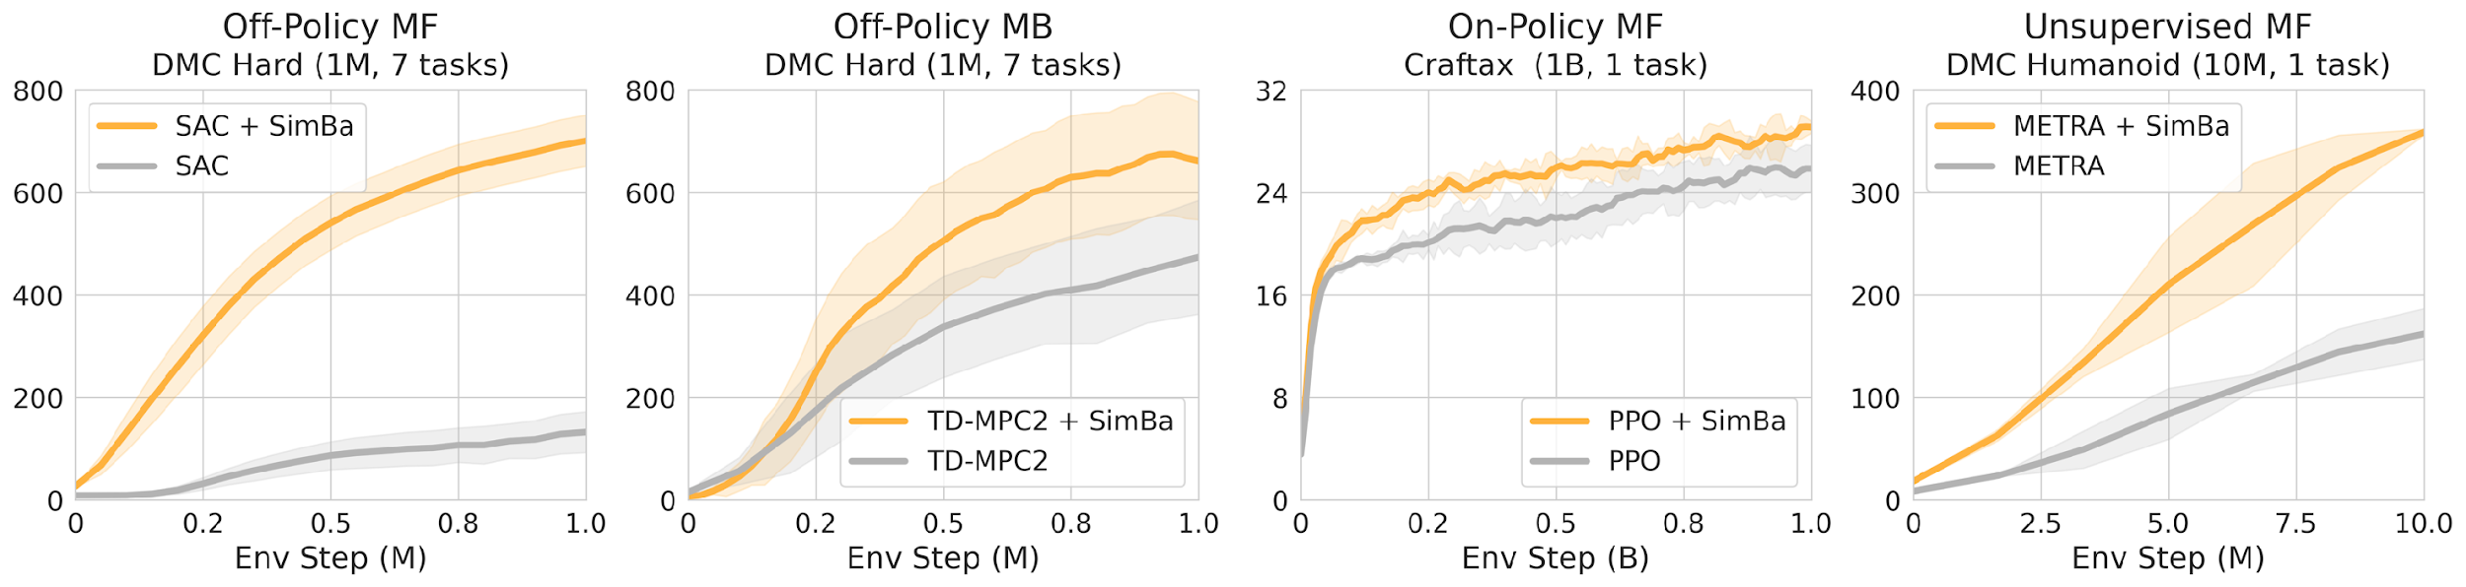
Performance of SimBa across Off-Policy, On-Policy, and Unsupervised RL methods
Notes:
SAC – Soft Actor-Critic, an off-policy RL algorithm balancing exploration and exploitation with entropy regularization.TD-MPC2 – Trajectory-Based Model Predictive Control v2, a model-based RL method for efficient decision-making.PPO – Proximal Policy Optimization, a popular on-policy RL algorithm ensuring stable policy updates. METRA – Meta Reinforcement Learning with Trajectories, an unsupervised RL approach for learning from diverse experiences.

Slide 40

Related Work
SimBa builds on advances in CV and NLP, where scaling network parameters with simplicity bias has led to strong generalization.
Incorporates proven techniques like observation normalization, residual feedforward blocks, and layer normalization to stabilize training.
Extends prior insights by applying simplicity bias principles directly to deep reinforcement learning architectures.
Demonstrates broad applicability, improving performance across off-policy, on-policy, and unsupervised RL algorithms.
Notes:
Observation normalization – standardizes game inputs for stable learning.
Residual feedforward blocks – provide efficient pathways for processing game states. Layer normalization – controls feature magnitudes to ensure consistent agent behavior.

Slide 41
Compute Efficiency of SimBa Across Diverse RL Benchmarks
Benchmarks – The graph evaluates performance on DMC E&M, DMC Hard, MyoSuite, and Humanoid Bench, covering diverse RL tasks.
Comparison – Shows returns achieved by SAC + SimBa, BRO, TD-MPC2, TD7, Dreamer V3, and SAC over compute time.
Efficiency – SAC + SimBa (yellow) consistently achieves higher rewards faster than baselines, demonstrating strong compute efficiency.
Generalization – The consistent advantage across multiple environments highlights SimBa’s scalability and adaptability in RL.
Notes:
SIMBA Consistently achieves faster learning and higher returns across off-policy, on-policy, and unsupervised RL methods.

Slide 42
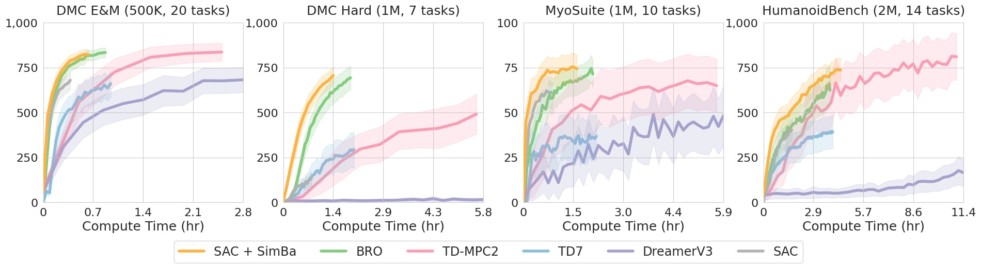
Compute Efficiency of SimBa Across Diverse RL Benchmarks
Notes:
Across all benchmarks, SAC + SimBa reaches higher rewards in less compute time compared to baselines.

Slide 43
Methodology
Integration with SAC – SimBa is integrated into the Soft Actor-Critic (SAC) framework, enabling it to match or surpass state-of-the-art performance.
Scalable Architecture – The methodology emphasizes scaling up network parameters while maintaining stability through SimBa’s architectural design.
Research Collaboration – The work represents a collaborative effort, with contributions during an internship at Sony AI.
Academic Contribution – The approach has been formally recognized and published at ICLR 2025, validating its significance in the RL community.
Notes:
SimBa-enhanced models beat strong methods like TD-MPC2, DreamerV3, and BRO, not just SAC.

Slide 44
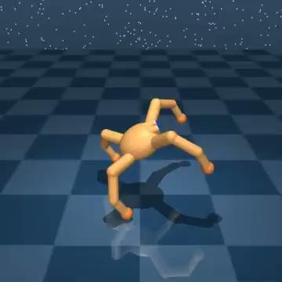
Experiments
Benchmark Selection – Experiments were conducted on DMC-Hard environments involving Humanoid and Dog tasks.
Base Algorithm – Soft Actor-Critic (SAC) was used as the primary reinforcement learning algorithm for evaluation.
Measuring Simplicity Bias – To quantify the effect of SimBa, Fourier analysis was applied as outlined in the methodology.
Evaluation Metric – A simplicity bias score was computed for each network by averaging results over 100 random initializations.
Notes:
The simplicity bias score is a measure that quantifies how strongly a neural network tends to prefer simpler, more generalizable solutions over complex ones when learning.

Slide 45
Scaling Performance of SimBa vs MLP on DMC-Humanoid with SAC
Setup – The graph compares SimBa and a baseline MLP architecture, both integrated with Soft Actor-Critic (SAC) on the DMC-Humanoid benchmark.
X-axis (Params M) – Represents the number of network parameters (0.1M → 10M), testing scalability.
Y-axis (Average Return ↑) – Measures the average performance (reward returns) achieved by the models.
Key Insight – SimBa scales efficiently, maintaining higher returns as parameters increase, while MLP performance degrades with larger models.
Notes:
MLP is a fully connected feedforward neural network with an input layer, one or more hidden layers, and an output layer. Multilayer Perceptron

Slide 46
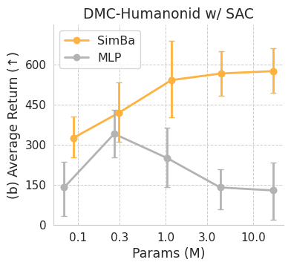
Scaling Performance of SimBa vs MLP on DMC-Humanoid with SAC
Notes:
Network parameters are the learnable weights and biases inside a neural network that are updated during training.

Slide 47
Simplicity Score Comparison – SimBa vs MLP
X-axis (Architecture) – Compares two neural network architectures: SimBa and MLP.
Y-axis (Simplicity Score ↑) – Measures the tendency of the network to favor simpler, generalizable solutions.
Result – SimBa consistently achieves a higher simplicity score (~6.4) compared to MLP (~5.8).
Key Insight – This demonstrates that SimBa integrates simplicity bias more effectively, enabling better scaling and generalization in reinforcement learning tasks.
Notes:
DMC Humanoid is a benchmark task from the DeepMind Control Suite (DMC).

Slide 48
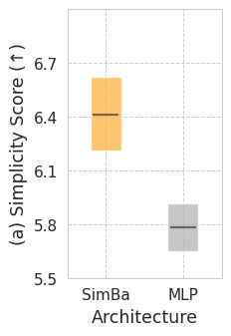
Simplicity Score Comparison – SimBa vs MLP
Notes:
dmc humanoid involves controlling a simulated 3D humanoid robot with multiple joints.

Slide 49
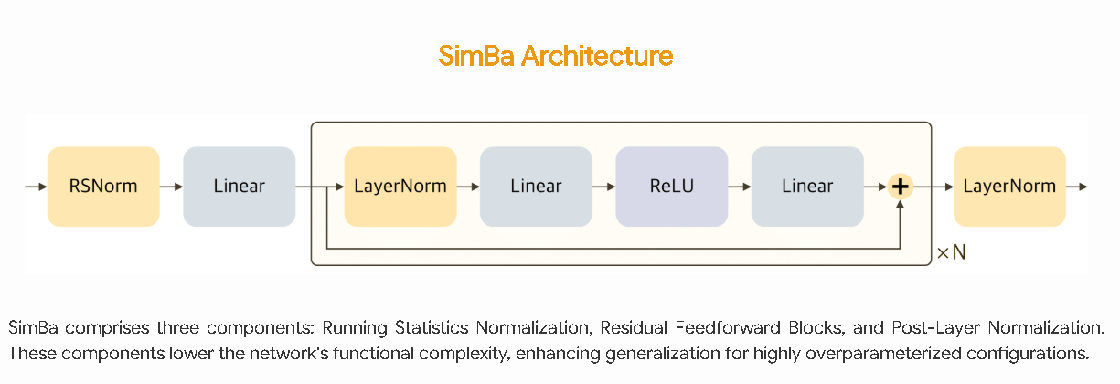
Core Components – SimBa integrates RSNorm, Residual Feedforward Blocks, and Layer Normalization to stabilize training.
Residual Pathway – The shortcut connection (+) ensures direct information flow, reducing vanishing gradients and aiding scalability.
Complexity Control – Normalization layers (RSNorm & LayerNorm) lower functional complexity, guiding the model toward simpler solutions.
Generalization Power – This design allows SimBa to scale up parameters efficiently, outperforming standard architectures in RL tasks.
Notes:
Github:https://sonyresearch.github.io/simba

Slide 50

Impact of RSNorm on Fourier Complexity and Average Return
Comparison Setup – The graphs compare SimBa, BroNet, SpectralNet, and MLP across different network widths (64 → 1024), both with and without RSNorm.
Fourier Complexity – SimBa maintains lower Fourier complexity (simpler representations) compared to others, especially when RSNorm is applied.
Average Return – With RSNorm, SimBa achieves significantly higher returns, scaling better with larger networks, while MLP lags behind.
Key Insight – RSNorm stabilizes training, allowing SimBa to fully leverage larger networks, outperforming other architectures in both simplicity and performance.
Notes:
RSNorm stands for Running Statistics Normalization, a normalization technique used in SimBa.

Slide 51
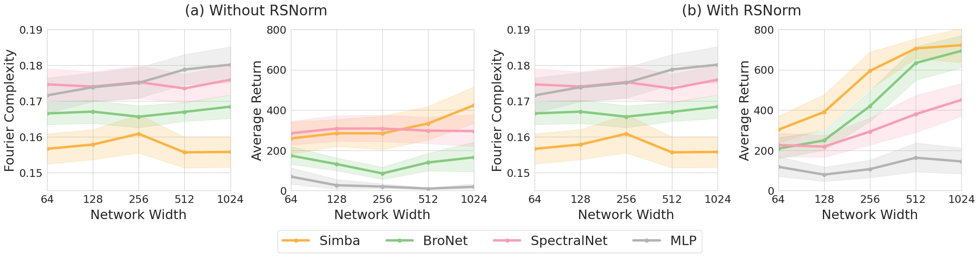
Impact of RSNorm on Fourier Complexity and Average Return
Notes:
RSNorm standardizes inputs using running averages of mean and variance, keeping feature scales stable during training.

Slide 52


metra
metra
SimBA
Notes:
Normalization layers (RSNorm & LayerNorm) lower functional complexity, guiding the model toward simpler solutions.

Slide 53
Why is Residual-MPPI useful in designing responsive and realistic AI behaviors in gaming scenarios?
Notes:
Residual-MPPI is generally faster than SimBa for real-time control tasks because it focuses on optimizing trajectories using corrective residuals, whereas SimBa simulates more complex, behavior-driven NPC interactions which can be computationally heavier.

Slide 54
Residual-MPPI (Model Predictive Path Integral)
Residual-MPPI is a real-time control method that helps game AI plan safe, optimal, and adaptive actions for characters or vehicles in dynamic environments.
Adaptive AI Control – Enables game characters or vehicles to plan optimal actions in real-time while responding to dynamic environments.
Safety and Constraint Handling – Ensures AI avoids collisions or unsafe moves, making in-game behavior realistic and reliable.
Customizable Behavior – Developers can tweak cost functions to prioritize speed, energy efficiency, or style of movement.
Improved Player Experience – Creates more responsive and intelligent opponents or NPCs, enhancing immersion and gameplay challenge.
Notes:
In Forza Horizon, AI can be set to race fast, save fuel, or drift stylishly by changing its priorities.

Slide 55
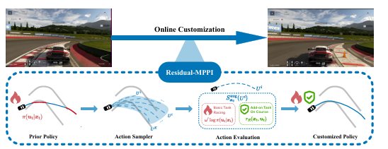
Prior Policy – The AI starts with a basic or default behavior (like a standard driving or movement policy).
Action Sampling – Residual-MPPI generates multiple possible actions (trajectories) for the AI to explore.
Action Evaluation – Each action is evaluated against goals (task completion) and constraints (safety, collisions, etc.) to pick the best one.
Customized Policy – The AI updates its behavior in real-time, producing safe, optimal, and player-tailored actions.
Notes:
Online Customization in Residual-MPPI allows the control policy to adapt in real-time to new tasks, environments, or user preferences by updating residual corrections during execution.

Slide 56
Why Residual-MPPI
Ensures safety in reinforcement learning for critical applications, such as autonomous racing.
Overcomes the limitations of existing RL policies that struggle under distribution shifts.
Provides customizable and adaptive control to suit different scenarios.
Residual-MPPI is designed specifically to tackle these challenges effectively.
Notes:
Distribution Shifts occur when the environment or input data changes from what a model or policy was trained on, potentially causing performance degradation.

Slide 57
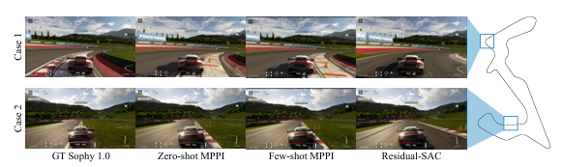
Comparison of Methods: The image shows two racing scenarios (Case 1 and Case 2) comparing the performance of different control methods: GT Sophy 1.0 (ground truth), Zero-shot MPPI, Few-shot MPPI, and Residual-SAC.
Visual Performance Differences: Each row illustrates how the car behaves under each method, highlighting differences in trajectory and handling on the track.
Improvement with Residual-SAC: The Residual-SAC method (last column) closely follows the GT Sophy 1.0 trajectory, indicating better adaptation and control compared to Zero-shot and Few-shot MPPI.
Track Context: The map on the right shows the segment of the track being tested, linking the visual frames to the actual racing path.
Notes:
Zero-shot MPPI: Executes Model Predictive Path Integral control in new scenarios without any prior task-specific training.
Few-shot MPPI: Adapts MPPI quickly to new environments using only a small amount of task-specific data.
Residual-SAC: Combines Soft Actor-Critic (SAC) with residual learning to refine policies and improve adaptability in dynamic environments.

Slide 58
Related Work
Offline reinforcement learning methods, such as AWAC and SAC, have been employed to achieve safe policy learning.
Residual policy learning enhances adaptability in dynamic environments.
Various MPPI variants, including Guided, Valued, and Greedy approaches, have been investigated.
Gran Turismo Sophy serves as a benchmark for evaluating advanced racing AI performance.
Notes:
AWAC (Advantage-Weighted Actor-Critic) is an offline reinforcement learning algorithm that improves policy learning by weighting actions according to their advantage, enabling safer and more efficient learning from pre-collected data.

Slide 59
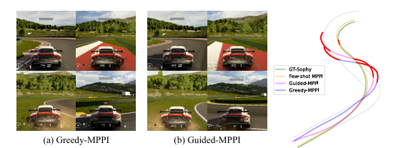
Comparison of MPPI Variants: The left two panels show racing scenarios from a rear-view perspective, comparing how the Greedy-MPPI (a) and Guided-MPPI (b) control the car on the track.
Trajectory Differences: The right panel shows the planned trajectories of different controllers: GT-Sophy (benchmark), Few-shot MPPI, Guided-MPPI, and Greedy-MPPI, highlighting how each method navigates the curve.
Performance Insights: Greedy-MPPI tends to take a more aggressive path, while Guided-MPPI follows a smoother and safer trajectory closer to the GT-Sophy benchmark.
Controller Behavior Analysis: The figure demonstrates that Guided-MPPI more accurately mimics the optimal benchmark trajectory, indicating better adaptability and safety compared to Greedy-MPPI.
Notes:
Greedy-MPPI is a variant of Model Predictive Path Integral control that selects the trajectory with the lowest predicted cost at each step, focusing on immediate optimal actions rather than exploring multiple alternatives.

Slide 60
Methodology(Overview)
Residual-MPPI combines classical Model Predictive Path Integral (MPPI) control with residual learning.
Introduces corrective adjustments to the standard MPPI trajectory sampling process.
Seamlessly integrates learned system dynamics into the planning loop for improved performance.
Enables zero-shot and few-shot customization for adaptive and flexible control.
Notes:
MPPI is a control algorithm that plans optimal trajectories by sampling multiple possible future paths, evaluating their costs, and selecting the best action sequence for dynamic and uncertain environments.

Slide 61
Applicables and Benefits
Technique | Application | Benefits
Transformer-Based Reinforcement Learning | Training complex game AI agents (e.g., StarCraft II) | Handles long-term planning, improves strategic decision-making, learns complex patterns
Multi-Agent Deep Reinforcement Learning (MADRL) | Team-based AI coordination in cooperative games | Enables collaboration, realistic group behavior, emergent strategies
Procedural Content & AI-Driven Narrative | Dynamic storylines and levels (e.g., AI Dungeon) | Increases replayability, personalized experiences, reduces manual content creation
SimBa for Real-Time Behavior | Adaptive NPC behavior | NPCs respond realistically to player actions, improves immersion
Residual-MPPI for Adaptive Control | Real-time vehicle or robot control in simulation games | Smooth and adaptive motion, robust performance in unpredictable environments
Notes:
Using these five techniques, a racing simulator could feature AI opponents that learn and adapt in real time (Transformer-Based RL & Residual-MPPI), dynamically generated tracks and challenges (Procedural Content), coordinated team behavior in multiplayer scenarios (MADRL), and realistic NPC reactions and story-driven events (SimBa & AI-Driven Narrative).

Slide 62

Conclusion
Interactive Learning – Video games provide an engaging platform to understand and experiment with deep learning concepts in real-time.
Safe Experimentation – Simulated environments allow testing AI strategies and behaviors without real-world risks.
Broader Applications – Techniques developed in games (e.g., adaptive control, multi-agent learning) are directly applicable to simulators, robotics, and real-world scenarios.
Innovation & Skill Development – Promoting deep learning through games fosters creativity, problem-solving, and prepares learners for diverse AI applications.
Notes:
Microsoft Flight Simulator uses deep learning to model realistic weather patterns, aircraft behavior, and air traffic, enabling highly realistic and adaptive flight simulation.

Slide 63


